Slide 1
Data Governance in TPM
Michael Henry P.E.
Staff Traffic Information Systems Engineer
System Information and Research Division
Arkansas Department of Transportation
TRC 2019
Hot Springs, AR
August 16, 2019

Slide 2
I am no expert but!!!
TRC 2019
Hot Springs, AR
August 16, 2019

Slide 3
What is TPM?
TRC 2019
Hot Springs, AR
August 16, 2019
Notes:
So, what is performance management?
According to FHWA in Short,
It is a systematically applied, regular ongoing process
It provides key information to help decision makers allowing them to understand the consequences of investment decisions across assets.
Improving communications between decision makers, stakeholders, and the traveling public.
Ensuring targets and measures are developed in cooperative partnerships and based on data and objective information.
The process consist of ten components and 26 sub-components.

Slide 4
Components of TPM
Strategic Direction
Target Setting
Performance-Based Planning
Performance-Based Programming
Monitoring & Assessment
Reporting & Communication
Organization & Culture
External Collaboration & Coordination
Data Management
Data Usability & Analysis
TRC 2019
Hot Springs, AR
August 16, 2019
Notes:
1. Strategic Direction – You establish the goals of your organization and decided what to measure to define success. “If one does not know to which port one is sailing, no wind is favorable” Lucius Anneaus Seneca
2. Target Setting – Here you will estimate how well you think you can do with current resources
3. Performance-Based Planning – Develop your strategy to hit your targets, also you will start you investment prioritization
4. Performance-Based Programming – Allocating money to implement your strategy.
5. Monitoring and Assessment – Check to verify if you initial estimates were correct or need to be modified.
6. Reporting and Communication – Let everyone know how you are doing and ensure everyone is on the same page.
A. Organization and Culture – This component is here to ensure you have an organization structure and processes to allow for success.
B. External Collaboration and Coordination – This one is to ensure you have a process to inform stakeholders and everyone is moving the same direction.
C. Data Management – Ensures that the data can be used for the following step. Includes the prep work for Data Usability and Analysis.
D. Data Usability and Analysis - Allows for the maximization of available data, you collect it why not use it to the fullest extent.

Slide 5
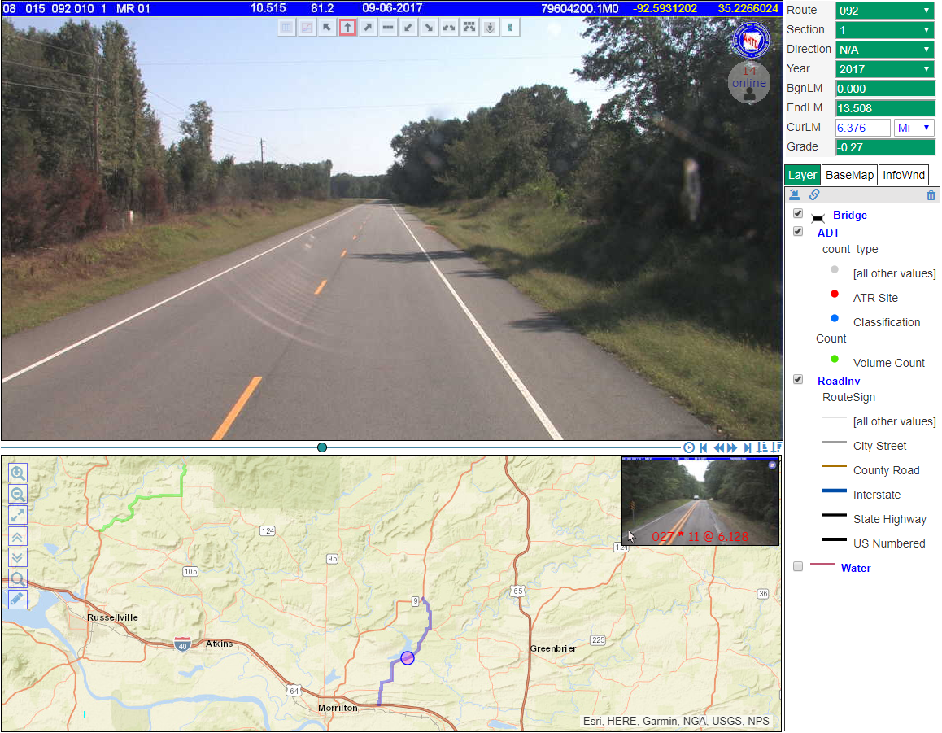
In A Perfect World
TRC 2019
Hot Springs, AR
August 16, 2019

Slide 6
Why Data Management?
Improves the accuracy, completeness, consistency, and timeliness of data
Provides a “single version of the truth” to use the analyses and reporting.
Enabling new analysis possibilities through providing more accessible data and data linkages.
Collecting and sharing data more efficiently across the agency and with agency partners.
Fostering a culture that understands and supports the value of data in the business process.
TRC 2019
Hot Springs, AR
August 16, 2019

Slide 7
Components of Data Management
Data Management
Data Quality
Data Accessibility
Improvement Processes
Validation Rules
Requirements
Data Standardization and Integration
Methods and Tools
Requirements
Integration Plan Implementation
Assessment
Data Collection Efficiency
Data Governance
Internal Coordination
Roles
Governance Structures & Policies
External Partnerships
TRC 2019
Hot Springs, AR
August 16, 2019
Notes:
Data Quality – Processes and organizational functions to ensure data are accurate, complete, timely, consistent with requirements and business rules, and relevant for a given use.
Data Accessibility – Processes and organizational functions to provide access to key data sets.
Data Standardization and Integration - Processes and organizational functions to integrate and compare data sets as needed
Data Collection Efficiency – Efforts to maximize use of limited agency resources through coordination of data collection programs across business units and partner agencies.
Data Governance – Establishing accountability and decision making authority for collecting, processing, protecting, and delivering data.

Slide 8
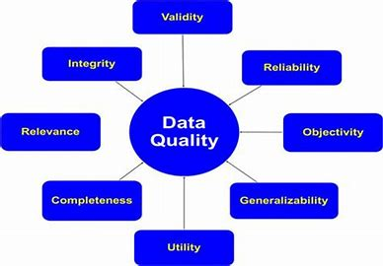
Data Quality
TRC 2019
Hot Springs, AR
August 16, 2019
Notes:
Establish Data Quality Requirement and Metrics
Create Data Validation Rules
Develop Quality Management Processes

Slide 9
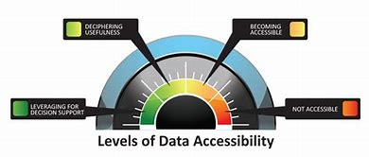
Data Accessibility
TRC 2019
Hot Springs, AR
August 16, 2019
Notes:
Establish Requirements for Different Audiences
Enhance Data Access Methods and Tools

Slide 10
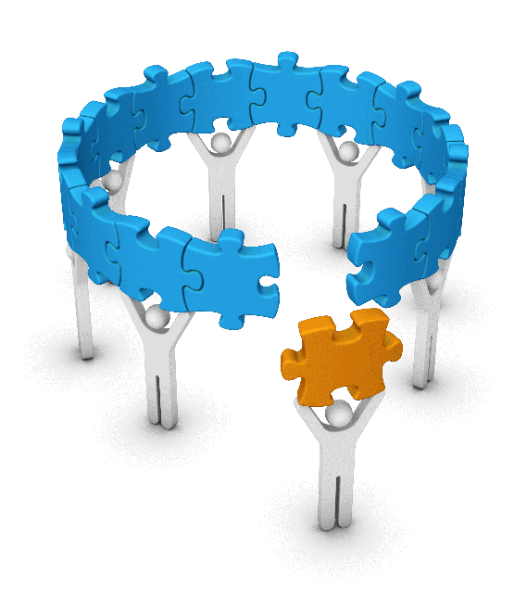
Data Standardization and Integration
TRC 2019
Hot Springs, AR
August 16, 2019
Notes:
Define Data Integration Needs and Standards
Create and Implement a Data Integration Plan

Slide 11
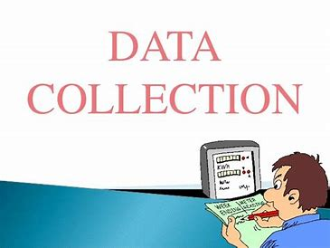
Data Collection Efficiency
TRC 2019
Hot Springs, AR
August 16, 2019
Notes:
Identify Opportunities for Data Collaboration

Slide 12
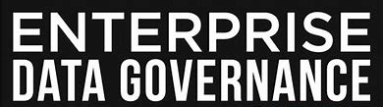
Data Governance
TRC 2019
Hot Springs, AR
August 16, 2019
Notes:
Define Roles and Accountability
Implement Governance Structures and Policies

Slide 13
Roles and Accountability
TRC 2019
Hot Springs, AR
August 16, 2019

Slide 14
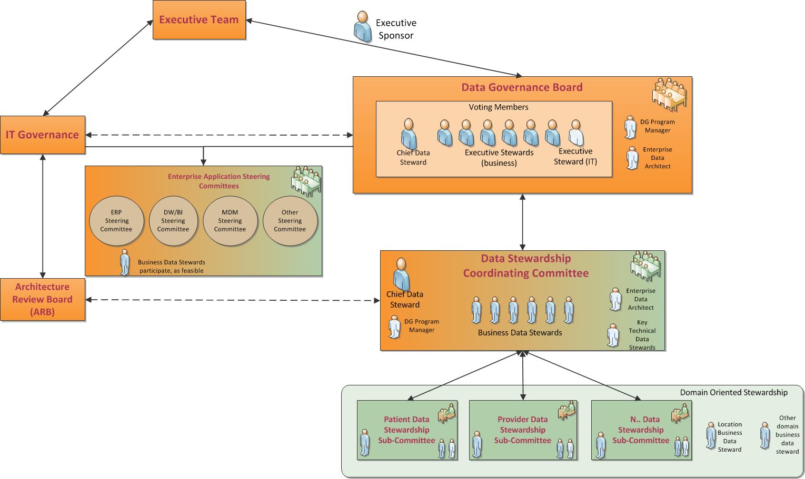
Governance Structure and Policies
TRC 2019
Hot Springs, AR
August 16, 2019

Slide 15
TRC 2019
Hot Springs, AR
August 16, 2019

Slide 16
Questions????
TRC 2019
Hot Springs, AR
August 16, 2019

